Slide 1
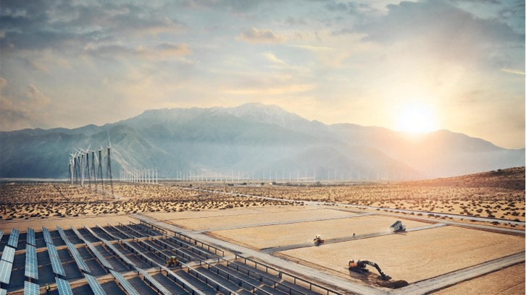
Volvo construction equipment building tomorrow
Corporate presentation 2023
Notes:
A world leading manufacturer
of premium construction equipment
Offering sustainable transport
& infrastructure solutions
With a wide range of services, contributing to our customers success
Worldwide footprint and distribution network

Slide 2
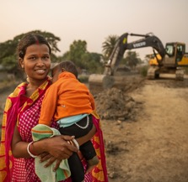

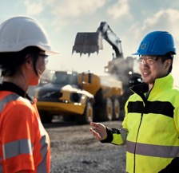
Our mission
Our Vision
Our aspirations
Be the most desired and successful transport and infrastructure solution provider in the world.
Have leading customer satisfaction.
Be the most admired employer
in our industry.
Have industry leading profitability.
Driving prosperity through transport and infrastructure solutions
Notes:
Every organization exists for a reason. It has a purpose. Our mission is to drive prosperity through transport and infrastructure solutions.
Our vision is our guiding star. The work we all do every day should ultimately contribute to us becoming the most desired and successful transport and infrastructure solution provider in the world.
The aspirations are there to guide us on our journey. Working towards these goals ensures that we are on the right track.

Slide 3
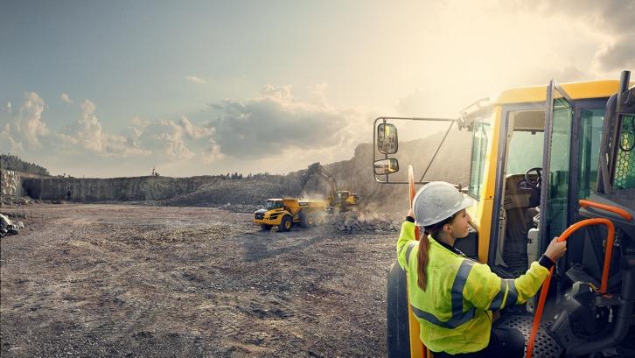
Our values
Customer success
Trust
Passion
Change
Performance
Notes:
Customer success
We truly understand our customers' business
We listen to and talk with our customers about their needs, desires and challenges
We focus on transport solutions that make customers successful and create value for society
We deliver on our promises
Trust
We are transparent and have respect for the individual
We trust other teams to do their best and we respect the decisions made
We collaborate easily and create excellent results through teamwork and open dialogue
We are empowered and have the courage to act
​​​​​​​
Passion
We are proud of the work and business we do
We are engaged and committed to meet our goals
We see how diversity strengthens us and try to bring out the best in everyone
We admit mistakes, fix them and learn from them
We are proud of our achievements, have fun and celebrate our successes
Change
We are curious about the world around us
We are innovative and find smart ways to create new solutions and business
We see change and transformation as a source of inspiration and energy
We are open-minded and share our knowledge
Performance
We have a strong business instinct
We have the skills, knowledge and intuition to do the right thing
We expect a lot from ourselves and others, and walk the extra mile to do a great job
We see the big picture and know when to let go of an idea, a project or a plan

Slide 4
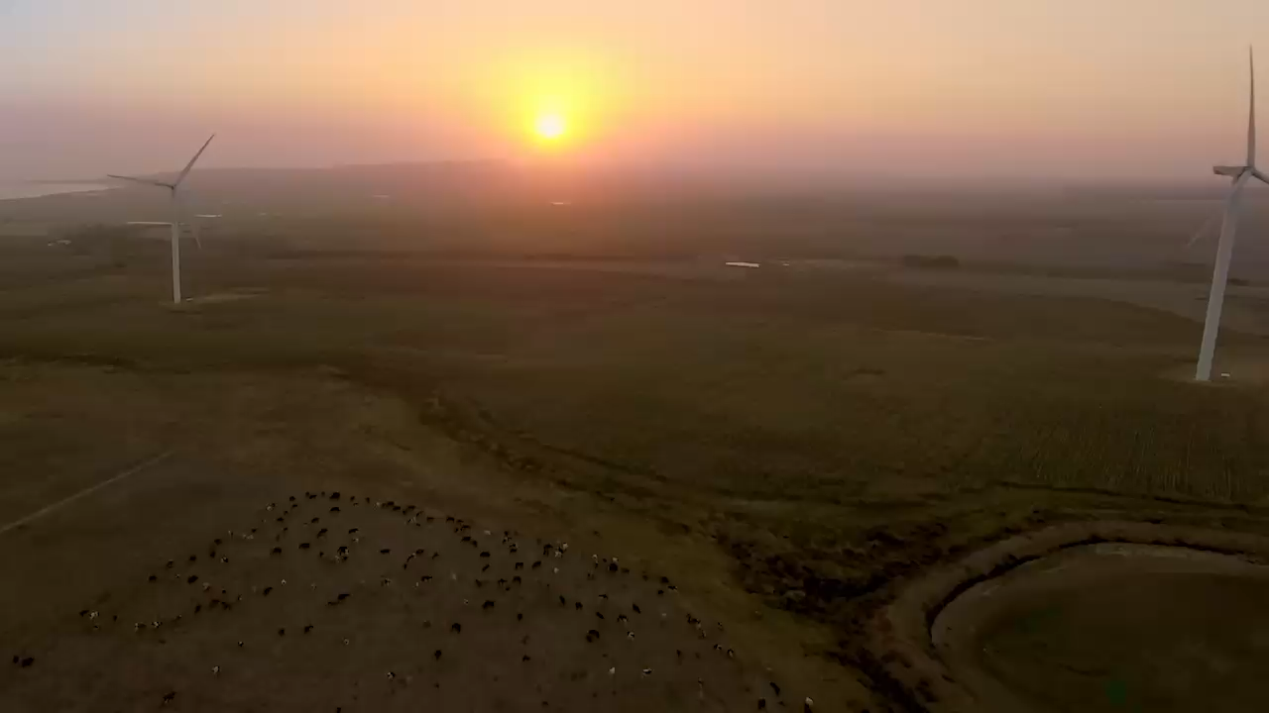

TO build the world we want to live in
Notes:
We are a company driven by people and together we have a purpose: To build the world we want to live in. Not just for our generation but also for many generations to come!

Slide 5
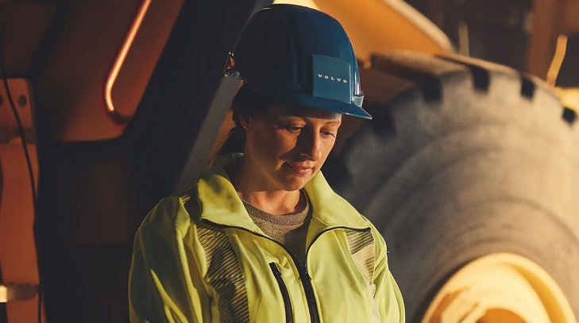
We believe in the power of people
We believe in us! We know that we all need something to strive for and need to have a sense of meaning and belonging. We want to:
Feel that we contribute to something bigger
Have a chance to learn and develop
Have a certain level of control
Be seen and appreciated for who we are

Slide 6

Assembled in
9 countries
Present in over
180 markets
15,500+ employees
worldwide

Slide 7


















Our three brands
Notes:
SDLG is a leading brand in the Chinese construction machinery industry, especially for wheel loaders. In 2006 the Volvo Group made a 70% equity investment into Shandong Lingong Construction Machinery Co., Ltd. This joint venture presents several strategic opportunities for the Volvo Group.
SDLG targets customers focused on robust and reliable products, best-in-class parts and service support that gives exceptional value for money.
The SDLG brand is sold primarily in China and other emerging markets.
Rokbak haulers are built in Scotland and loaded with generations of experience and pride. Many of our highly-skilled team have worked with us for decades – like their parents and even grandparents before them.
Two types of articulated haulers: RA30 and RA40.

Slide 8
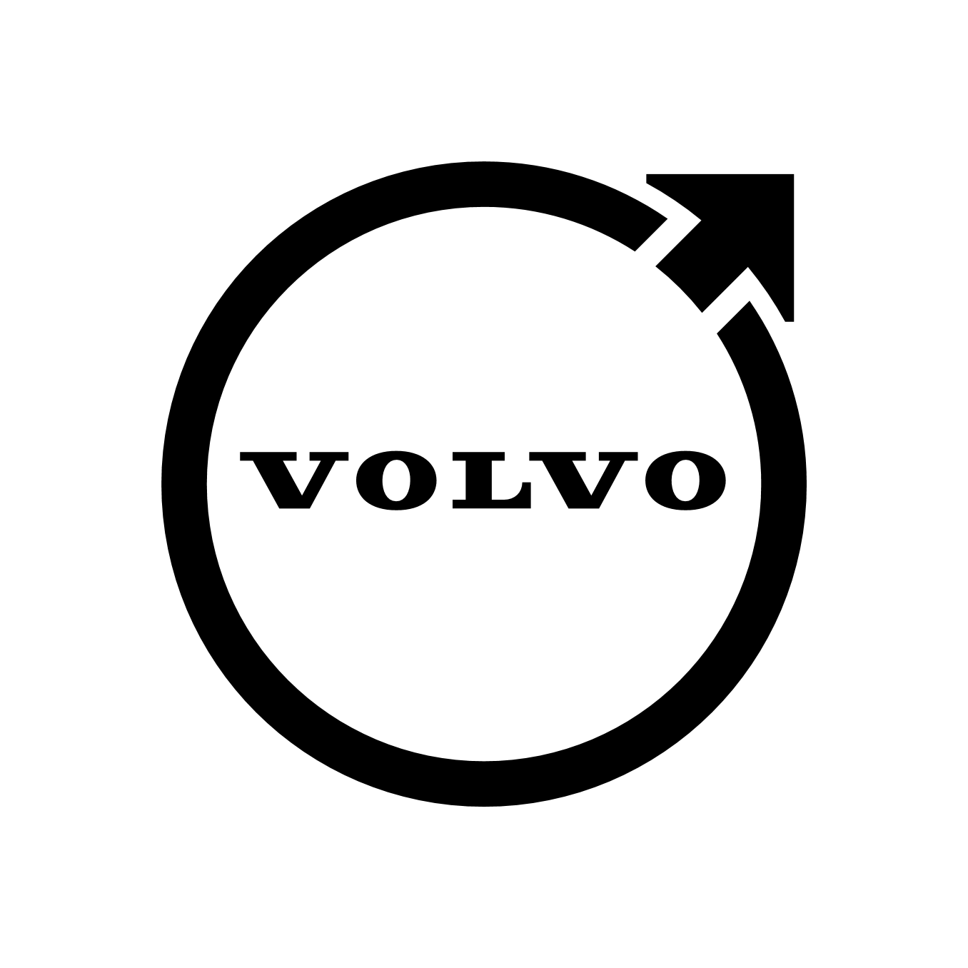

Volvo CE – product portfolio coverage
Platform structure and sub-platforms (sizes) for all three brands
Wheel
Loaders
Crawler
Excavators
Wheeled
Excavators
Articulated Haulers
Rigid
Haulers
Motor
Graders
Backhoe
Loaders
Pavers
Asphalt Compactors
Soil
Compactors
Midi
Small
Medium
Large
Heavy
No. of machines | 65 |  | 92 |  | 14 |  | 17 |  | 4 |  | 7 |  | 3 |  | 20 |  | 20 |  | 22
Size class
Notes:
Large portfolio, grown over decades and through acquisitions
Maintenance took place (stop grader, backhoe, milling)
CAST (Common Architecture & Shared Technology) approach for Excavators, Wheel Loaders and Road (compaction)
Transition towards electromobility will further streamline the platforms and help with CAST component platforms

Slide 9
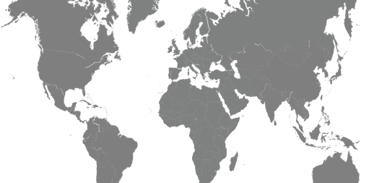
Global footprint
Arvika, Sweden
Eskilstuna, Sweden
Motherwell, UK
Hallsberg, Sweden **
Braås, Sweden
Shippensburg, US
Hameln, Germany
Changwon, Korea
Wroclaw, Poland
Linyi, China
Konz, Germany
Jinan, China
Pederneiras, Brazil
Belley, France
Bangalore, India
Shanghai, China
Plant
R&D
Notes:
Halsberg From left to right:
Wheel Loader cab
Articulated Hauler cab
Excavator cab
Wheel Loader hydraulic oil tank

Slide 10








Volvo CE Services
Volvo CE Products
Premium customer solutions and brand experience
Machine
Uptime
Operator
Performance
GPE
Machines Range
Compact
Machines Range
=
+
Fleet and Site
Productivity
Business
Solutions
Road
Machines Range
Parts and
Attachments
Notes:
Our key purpose is to create a premium customer experience. In order to do that we need to be able to deliver the best Services and to provide the best Products solving our Customer pain points.
The focus for Services is to cover the full Customer business lifecycle
- Machine Uptime
- Operator Performance
- Fleet and site Productivity
- Business Solutions

Slide 11
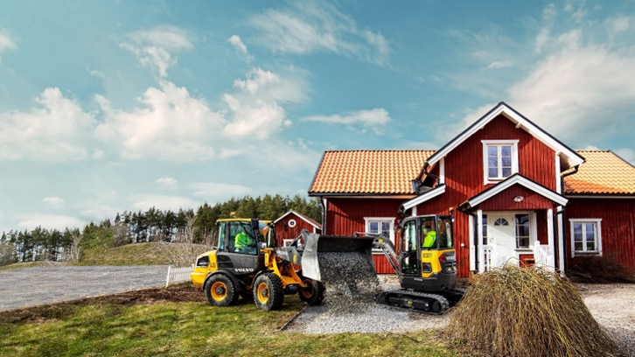
Strong swedish heritage
Notes:
Long lasting heritage, since 1832
Part of Volvo Group
Global presence and expertise
Proven track record in innovations

Slide 12
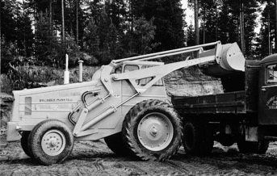
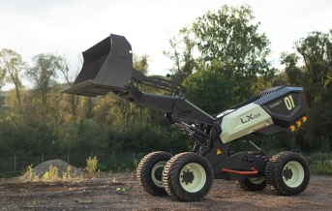
Building on almost two centuries of innovation
Notes:
For us at Volvo CE, change is nothing new: as a company we have almost 200 years of innovation behind us. Our ability to adapt, reinvent ourselves and be innovative is what has driven our success for two centuries. Now more than ever, we need to continue this evolution and be a sustainable leader, not just for our company, but for our industry and society as a whole.
To continuously drive transformation, we are constantly exploring and testing new concepts. On the left you see one example, the Volvo LX03 prototype which is one of our Concept Lab prototypes, recognized by its orchid green color.
With Volvo Concept Lab we are showcasing and testing cutting-edge ideas and innovative concepts. These are not commercial products.
Enabling valuable dialogues with our customers and partners
Pushing boundaries to accelerate the transition to a sustainable future
About the LX03
The LX03 is a battery-electric autonomous wheel loader concept in development to have self-learning capabilities with a brain that has the capacity to adapt, make decisions, and collaborate with humans.
While the prototype is one of Volvo CE’s most advanced demonstrations yet into machine automation, it’s not commercially available and still part of our continuing exploration into machine intelligence.
It is being designed to be a smart and safe worker that can be programmed by customers to complete for example heavy and repetitive tasks, reducing the need for a human on site.
The LX03 is inspired by the LEGO® Technic Concept Wheel Loader ZEUX, a concept jointly developed by Volvo CE and LEGO Group. And is also the first time a LEGO® Technic model has been turned into a real machine.
https://www.volvoce.com/global/en/this-is-volvo-ce/what-we-believe-in/innovation/lx03/

Slide 13
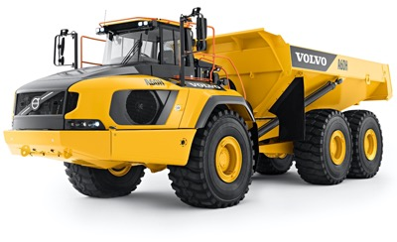
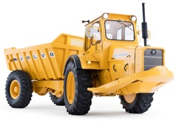
A proud part of our history
More than 50 years of articulated haulers
In June 1966, the world’s first series produced, AWD and articulated hauler, DR631 – ”Gravel Charlie” – rolled out of our factory in Braås, Sweden.
TODAY: Market leader in articulated haulers.
40% market share globally.*
*) 2021 figures
Notes:
The world’s first series produced, all wheel driven and articulated hauler, DR631, was founded in Braås, Sweden, and rolled out of our factory in June 1966. It had four wheels, 10 tonnes payload and a motor with 65 horsepower. It soon got the nickname Gravel Charlie, named after the company’s owner and CEO Carl Lihnell. The idea was to get better terrain capability for heavy loaded tractor and trailer units. It was solved by moving the tractor’s steering from a pair of front wheels to an articulated joint between the tractor and the trailer, and also by making the vehicle all wheel driven. From a clever and brave idea, sketched on a piece of paper by a young engineer, to a first test drive under the cover of a dark evening, it took only three months. The project was highly secret and just a few people were involved, working in evenings and nights. It came out to be a success and already in 1968 it was joined by the slightly bigger and bogie equipped DR860.

Slide 14
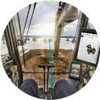
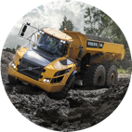
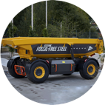
Safety, Quality, Environmental Care
Safety is in our DNA
Health, safety and wellbeing is of utmost importance to us, to our customers, and to society.
Quality in all we do
Machines developed and tested for the toughest of conditions.
Committed to leading the change
Reducing carbon footprint in the full value-chain.
Notes:
Safety, Quality, Environmental Care are our core values.
Safety is in our DNA: We nurture a culture of care where product safety, healthy working environments and wellbeing among our employee and stakeholders contributes to our safety vision
Quality in all we do: Manufactured in our own facilities, with full control of the quality of every component, collaborating with selected suppliers and partners.
Keeping the operation running smoothly with Uptime services, going from preventive to predictive maintenance and support.
Increased efficiency and job quality with productivity services such as the ‘Assist’ family and Volvo Co-Pilot.
Committed to leading the change: Increasing the use of sustainable energy sources.Leading the way with the industry’s first carbon neutral plant.Driving resource efficiency through circular life-cycle approach. Minimizing waste from industrial sites with landfill-free sites program.

Slide 15
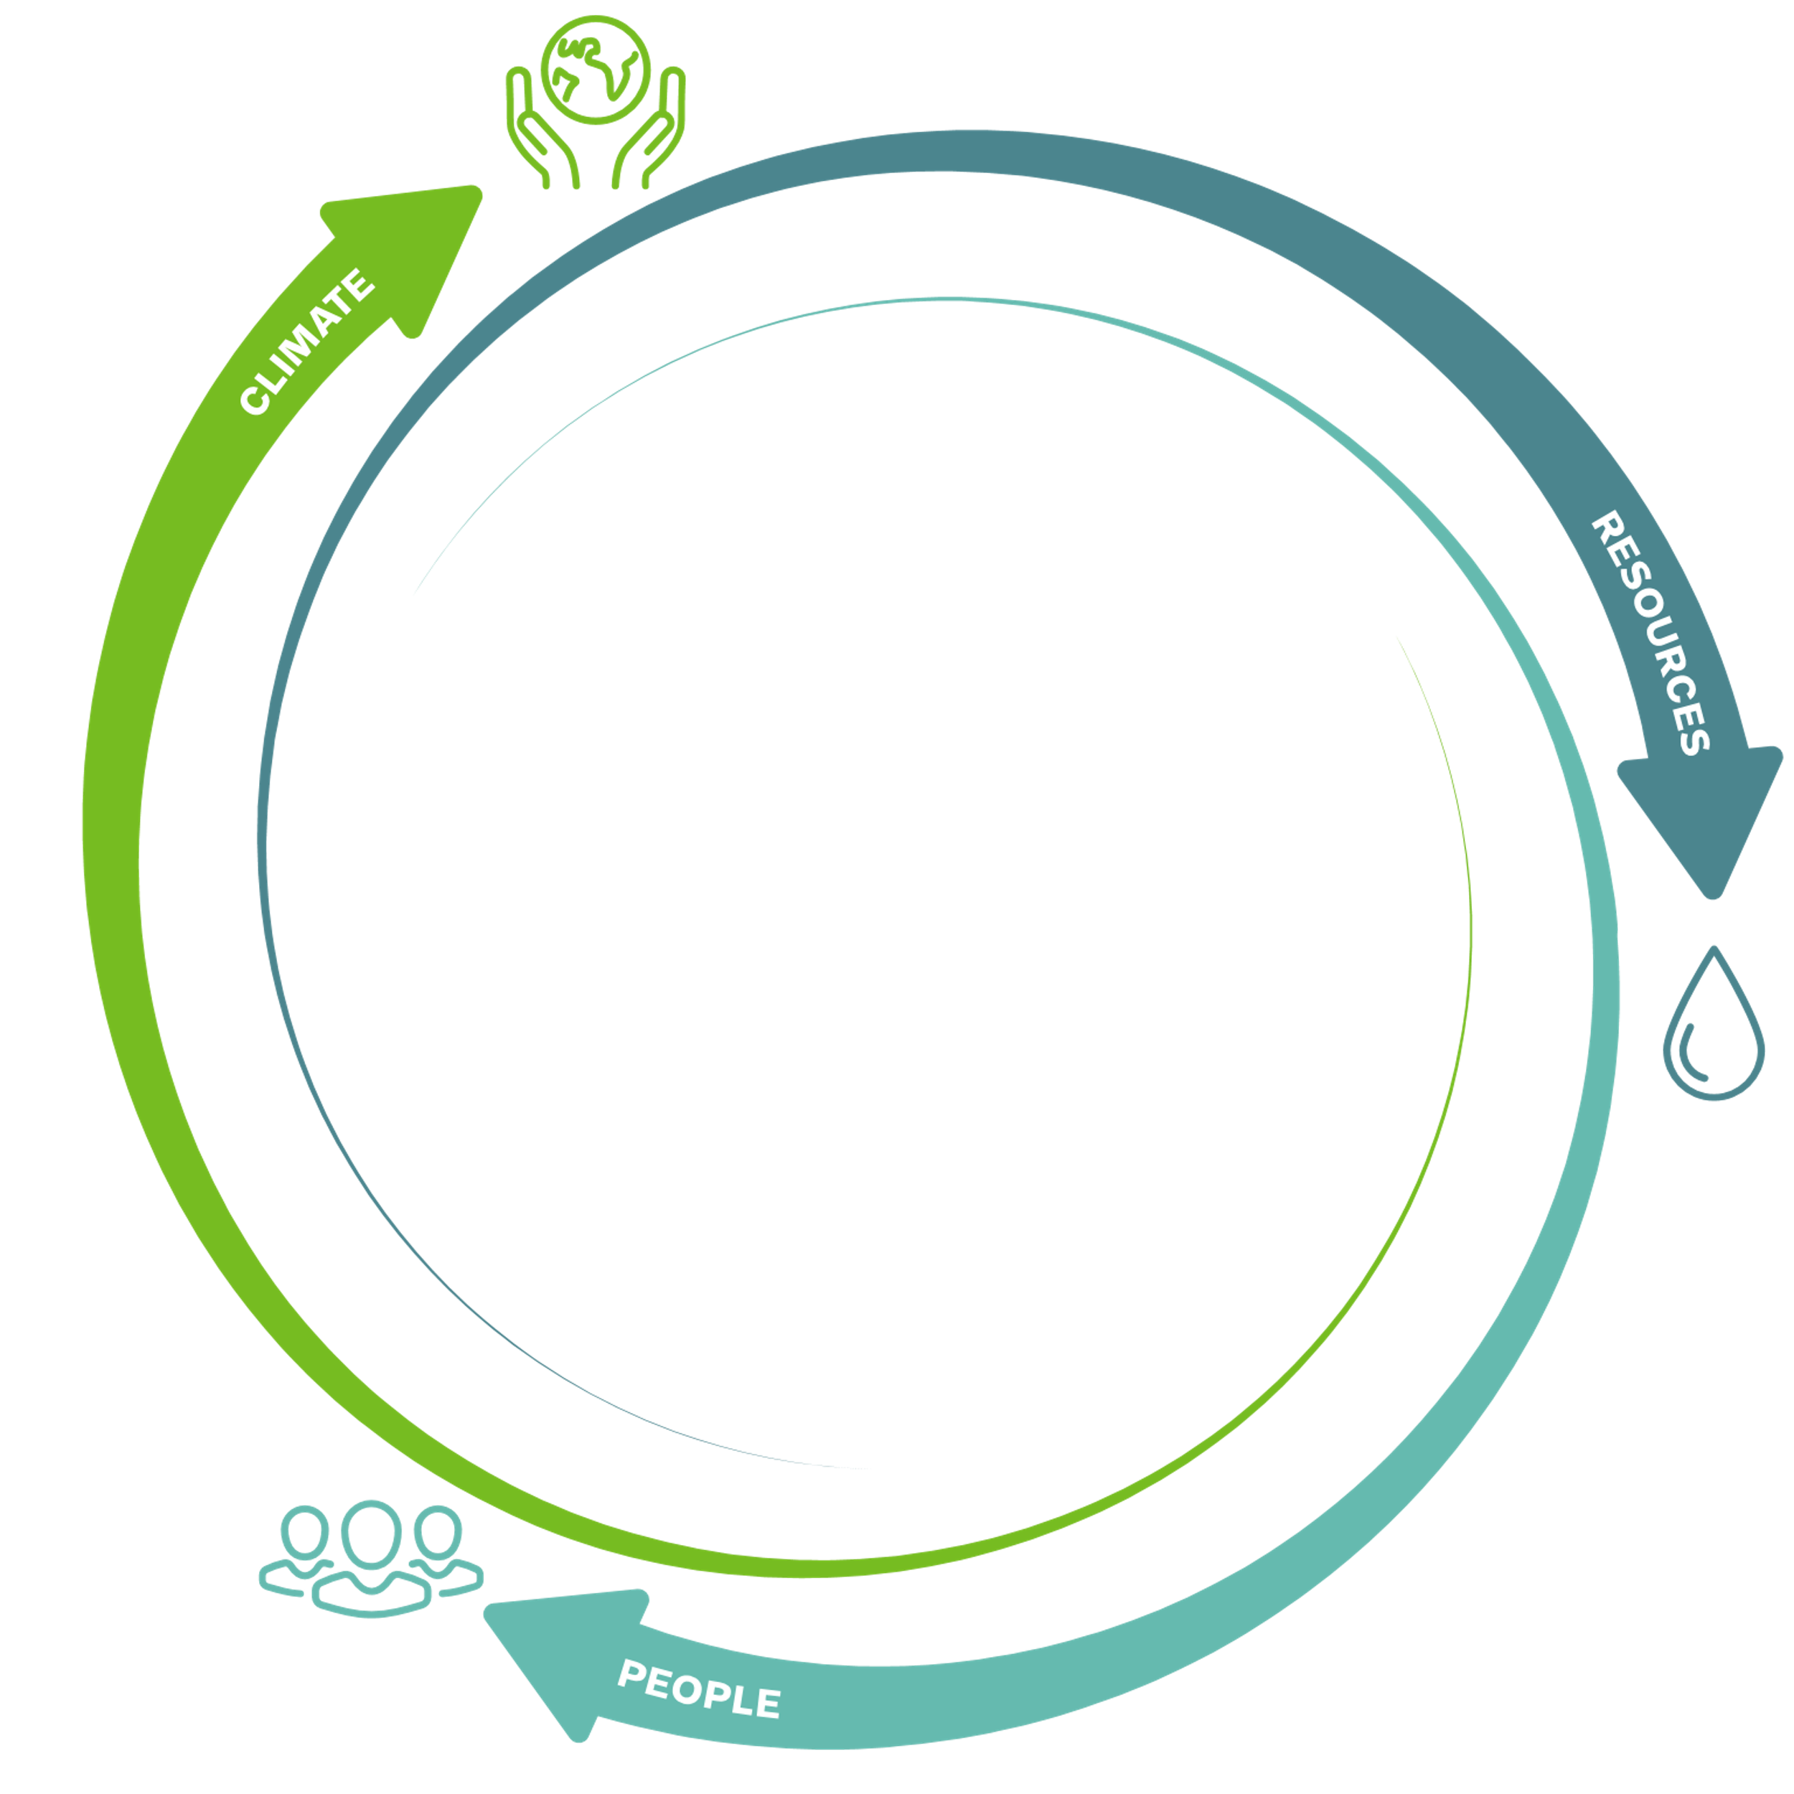

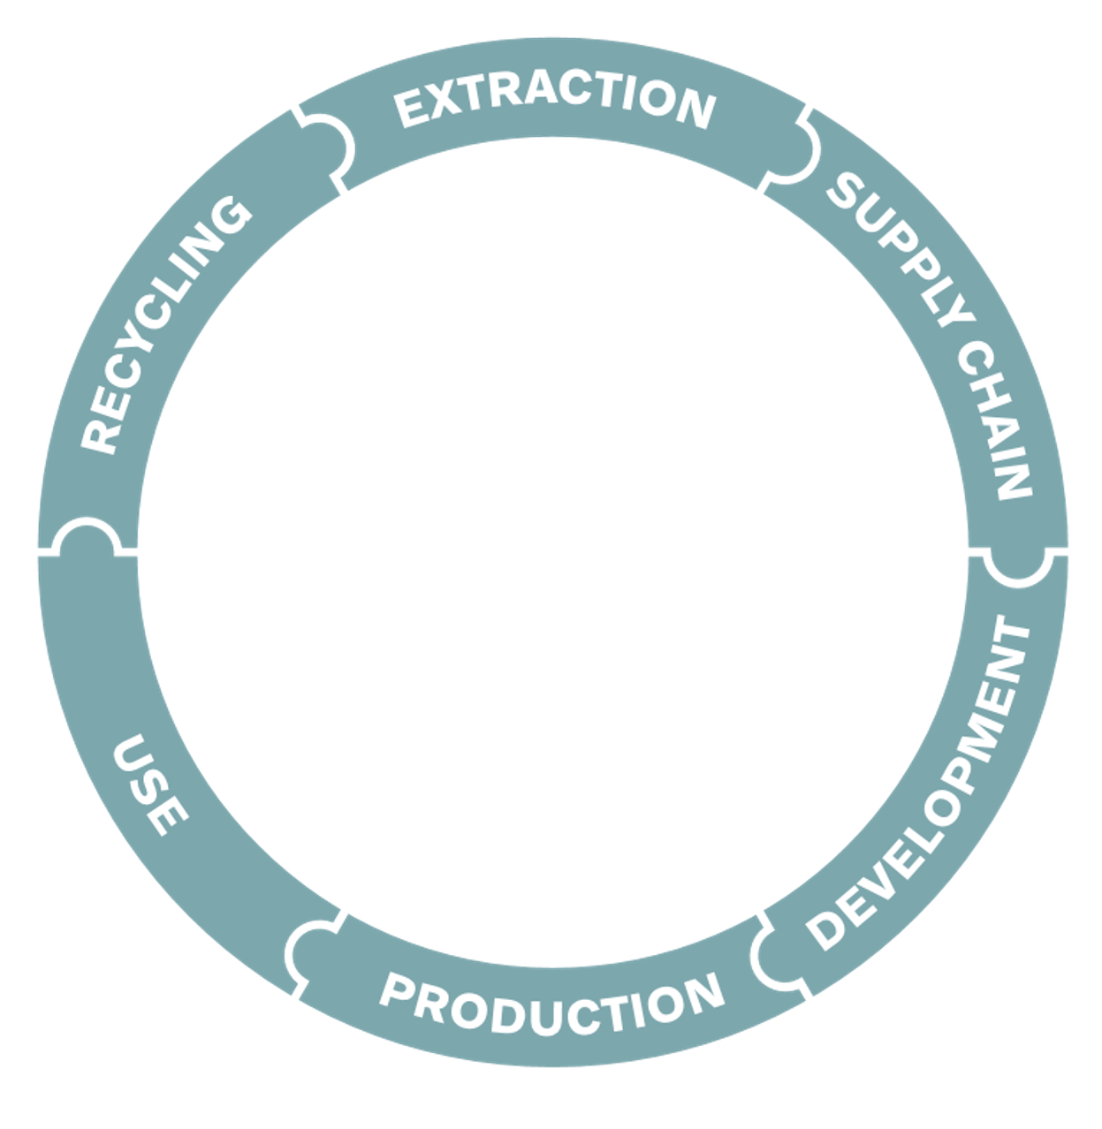

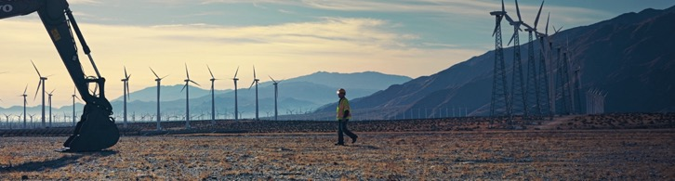
Our sustainable approach at Volvo CE
People-centric, with safety, health and well-being at our core
A holistic life-cycle perspective in the entire value chain with circularity approach
Close collaboration with stakeholders and partners
Focusing our efforts within three key areas:
CLIMATE, RESOURCES, and PEOPLE
Notes:
At Volvo CE we believe there are certain key elements which need to be in place, enabling us to be truly sustainable:
People are always in the center, with safety, health and wellbeing at the core of all we do
To be truly sustainable, all parts of the value chain needs to be in scope, from extraction of raw materials to end of products or preferably recycling. Because we are striving for a circular mindset taking care of the earth’s resources.
All stakeholders are important for success in our sustainability ambitions. We take input from and deliver to all stakeholders in a balanced way.
Our overall sustainability key areas are CLIMATE, RESOURCES and PEOPLE

Slide 16
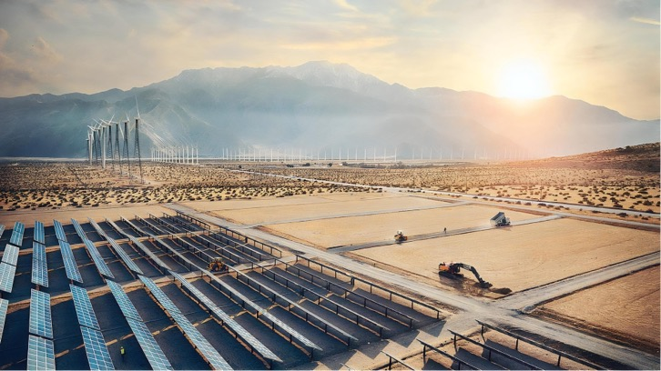
Contributing to the UN Sustainable Development Goals
Notes:
As a signatory of the United Nations (UN) Global Compact and supporter of the UN 2030 Agenda for Sustainable Development, Sustainable Development Goals (SDGs) – that outlines the world’s common agenda for 2030 - we are continuously considering global trends and challenges, international norms of responsible business behavior, and stakeholder expectations through our sustainability strategy when developing our work. Several of these topics, such as gender equality and fighting corruption are universal for all enterprises. Beyond these universal responsibilities, we focus on the SDGs where our business activities can have the biggest impact.
We believe in collaboration to drive change, and together with our customers, supply chain partners, governments, societies and other stakeholders, we are acting to have a positive contribution to these goals.

Slide 17
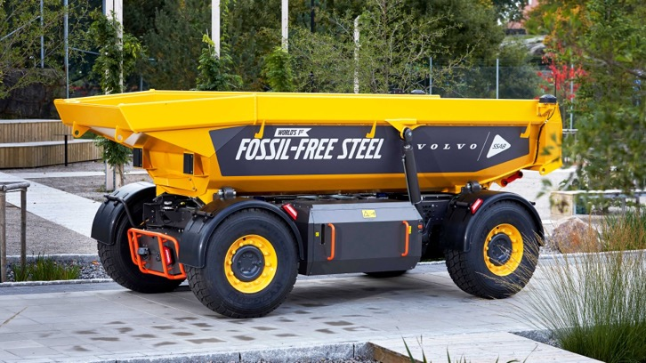
Long term ambitions
100%
Safe
Fossil-free
More productive
Notes:
The world’s first machine made with fossil free steel – the TARA autonomous hauler, in cooperation with Swedish steel maker SSAB and Volvo Autonomous Solutions.

Slide 18





Volvo CE is set to reach net-zero value chain greenhouse gas emissions by 2040
Supply partners
Own operations
Product use
End of life
Work together with our supply partners to secure their contribution
Reduce emissions in our own operations by 50%
-30% in absolute reductions
Focus on circularity
Volvo CE’s interim goals by 2030
set in line with Science-Based Targets
Notes:
In order to deliver on our commitment to the Paris Agreement, the entire running fleet provided by Volvo Group needs to run on
100% fossil-fuel free fuel by 2050.
However, since it takes in average ten years for the customers to renew their rolling fleet the Volvo Group target is that all products delivered from the Group already in 2040 shall reach Net zero status.
To make it happen, we have set a milestone target that by 2030 >35% of our sales should be electric.
(Both the interim targets are absolute - meaning we commit to reduce the emissions levels 50% respectively 30% below the 2019 outcome, independently of 2030 sales and production volumes.)

Slide 19
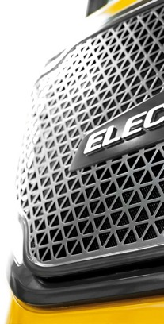
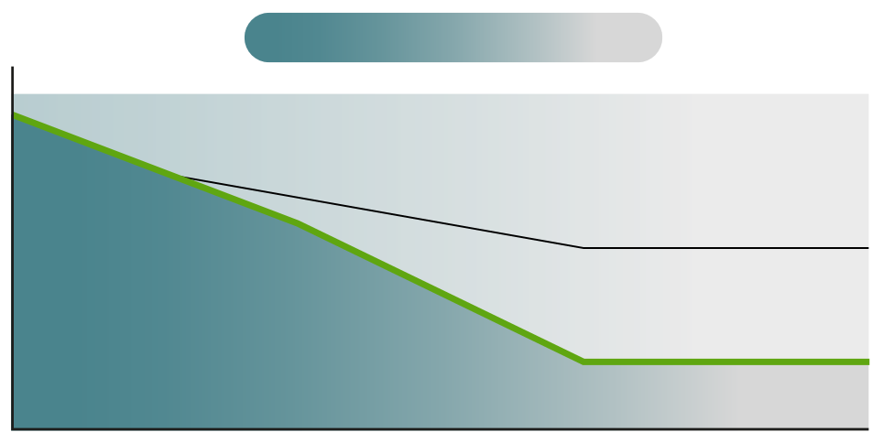
Our sustainable power journey towards net-zero emissions
CARBON FUEL
CARBON NEUTRAL
100%
BATTERY ELECTRIC
SHARE
OF NEW
MACHINES
ROLLING FLEET
FUEL CELL ELECTRIC
COMBUSTION ENGINE
ALTERNATIVE FUELS
0%
2020
2030
2040
2050
35% electric vehicles by 2030
Notes:
To contribute to an emissions-free future, there will be a steady shift into electric propulsion with battery electric and hydrogen fuel-cells, and combustion engines will increasingly run on biofuels.
Electrification of commercial vehicles will play an important role on the journey towards a carbon neutral society, and is changing the world of construction, both rapidly and fundamentally. ​
An electric machine can achieve zero carbon emissions, and compared to conventional machines, electric powered machines are also more efficient and very quiet. As a result, this means that they can work through the night without causing disturbance to nearby residents. This is a game changer – contractors will be able to work whenever they want with greater flexibility. This transition will involve technological development, new business models, new driving behaviors, new policies, and new connections between industries. ​
By embarking on this journey with our suppliers and customers, we'll be able to understand the reduction of emissions, as well as change in total cost of ownership and value creation – and that's exactly what we're doing in our electromobility projects. ​
Our ambitions are very high and at Volvo CE, we are committed to taking the lead to push the innovation progress in this area.​
​
We have set the ambition to have at least 35% fully electric vehicles sales by 2030.

Slide 20










Driving speed of change by leveraging our strong partners
Volvo Group +
Samsung SDI
Volvo Group
+ Aurora
Volvo Group
+ SSAB
Volvo Group +
Designwerk Technologies
Volvo Group
+ Nvidia
Volvo CE
+ NorrHydro
Volvo Group
+ Cellcentric
Volvo Group
+ Ovako
Volvo Group +
Daimler + TRATON
Volvo Group
+ Holcim
Notes:
In July 2022, we communicated that Volvo Group, Daimler Truck and the TRATON GROUP have signed a non-binding agreement to install and operate a high-performance public charging network for battery electric heavy-duty long-haul trucks and coaches across Europe.
In June 2022, we communicated a new partnership with Ovako, a Swedish/Finnish steel manufacturer. This is a partnership on green hydrogen, like the one we have with SSAB.
SSAB collaboration. We world’s first fossil-free steel has been delivered to us at Volvo Group. This means Volvo Group is the very first customer of the world’s first fossil-free steel deliveries!
We hosted a media event together with SSAB and Ovako in mid-October at CampX in Lundby.
Volvo Group & Aurora. Press release Sept 14: Aurora Debuts Volvo’s First Commercial Autonomous Truck for U.S. Highway Market

Slide 21
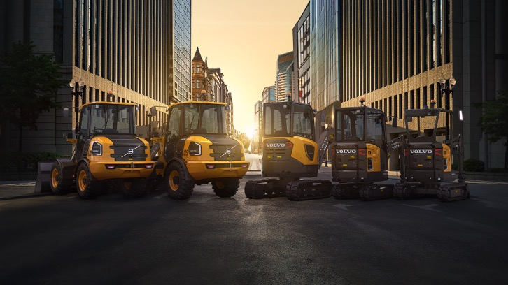
Driving transformation
Broadest electric range in the industry
Ramping up towards 35% of all products electrified by 2030
More efficient, low noise
Zero carbon emissions
Notes:
Electromobility is changing the world of construction, both rapidly and fundamentally, and electric solutions have never been more important. From construction to cars, industries across the board are investing in 'greener' technologies to meet today’s challenges and we all need to act to reduce emissions.
An electric machine can achieve zero carbon emissions, and compared to conventional machines, electric powered machines are also more efficient and very quiet. As a result, this means that they can work through the night without causing disturbance to nearby residents. This is a game changer – contractors will be able to work whenever they want with greater flexibility. This transition will involve technological development, new business models, new driving behaviors, new policies, and new connections between industries.
By embarking on this journey with our suppliers and customers, we'll be able to understand the reduction of emissions, as well as change in total cost of ownership and value creation – and that's exactly what we're doing in our electromobility projects.
Our ambitions are very high and at Volvo CE, we are committed to taking the lead to push the innovation progress in this area.

Slide 22
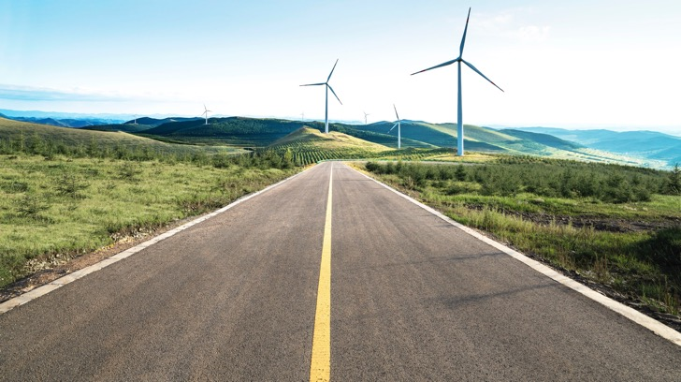






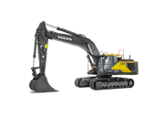





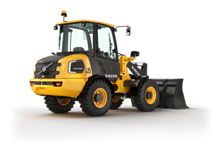
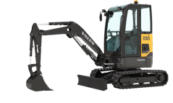
Our product path towards zero emission
Hydrogen Fuel Cell / Alternative Fuels
Motion recuperation
Cable Electric
Battery Electric
HEAVY
LARGE
MEDIUM
COMPACT
Notes:
We electrify from smaller machines and up.
For the largest machines, we anticipate we need to go to fuel cell and cable electric technology. A fuel cell machine is an electric machine
We are exploring fuel cells as an alternative sustainable power since we think this technology is very promising. But there are still areas that need to be solved, it will take some time before fuel cells will be a high volume commercial solution in our business.

Slide 23
Together we
build the world
we want to live in.
Thank you!
Notes:
We are a company driven by people and together we have a purpose: To build the world we want to live in. Not just for our generation but also for many generations to come!

Slide 25
ADDITIONAL SLIDES TO PICK FROM
Volvo CE facts & figures
Volvo Group facts & figures
Volvo CE in different industry segments

Slide 26










Volvo Group
Ten strong brands under one roof
Renault
Trucks
Mack
Trucks
Volvo
Trucks
Volvo
CE
Volvo
Buses
Volvo
Penta
Volvo
Energy
Volvo Financial
Services
Volvo
Autonomous
Solutions
Arquus

Slide 27

Our employees
May 2022 figures, include temporary employees, hired services and consultants, SDLG, Rokbak and Owned Dealers.

Slide 28
Construction Equipment
Construction Equipment’s financial performance 2018–2022.
2022:13.2%
2021: 13.3%
2020: 12.4%
2019: 13.4%
2018: 13.4%
Adjusted
operating margin:
Net sales (BSEK)

Slide 29












Volvo CE executive management team
Melker Jernberg
Head of Volvo CE
Bill Law
Brand, Marketing & Communications
Philippe Henriette
Finance, D&IT and Business development
Ann-Sofie Räftegård
Human Resources
Henrik Wetter
Legal (Interim)
Kamel Sid
Operations (interim)
Adriana Munhoz Rochaz
Executive Assistant
Stephen Roy
Region North America
Carl Slotte
Region Europe & International
Tomas Kuta
Region Asia
Peter Jordansson
Purchasing
Thomas Bitter
Technology

Slide 30
Volvo CE Customer types and Industry segments
Customer types*
Industry segments*
*) As of December 2020
Notes:
The doughnut on the left-hand side of the slide presents you with an overview of the Volvo CE customers in 2020 grouped along key profiles:
contractors (companies working on various job sites to perform contracted work),
Producers (companies purchasing units to be working on defined locations ex: quarries)
Rental providers (independent rental companies or dealer rental fleets
Governments (all public authorities be it National/Federal or local)
Other groups of customer such as Educational or Auction houses
The doughnut on the right-hand side of the slide presents you with an overview of the various industry segments our equipment was sold into during 2020. The building segment is split between contractors and rental activities which are reported to be operating into the building business.
For more details on the segmentation split, please contact your local Global marketing representative.

Slide 31
The growth of Volvo CE from aquisitions (units)
Notes:
This slide presents you with of an overview of the steps taken by Volvo CE to become the company that it is today.
The starting point is the Volvo BM company which was specialized in GPE Wheel Loaders (L50 and above) and the articulated haulers
The Volvo GPE wheel loader range was extended with compact wheel loaders thanks to the acquisition of Zettelmeyer (Konz, DE) in 1990
The compact equipment family was extended with compact excavators (0<10tons) with the acquisition of PelJob (Belley, FR) in 1995
The Road range was initiated with the Motor Grader line and the acquisition of Champion Road Machinery (Goderich, CA) in 1997. In November 2014, it was decided to discontinue this line in favour of the SDLG branded models
The full range of Excavators was secured through the acquisition of Samsung CE (Changwon, KR) in 1998
Volvo launched its in-house designed backhoe loader (Wroclaw, PL) in 2002. In November 2014, it was decided to discontinue this line in favour of the SDLG branded models.
It started selling skidsteer loaders further to the purchasing of Skat Track in 2003.
It reinforced its presence in China, the world’s largest market of construction equipment while embarking into a dual brand sales strategy in 2006 further to becoming a majority stakeholder in a joint-venture with Shandong Lingong Construction Machinery (Linyi, CN) in 2006
The Road range was reinforced with the acquisition of Ingersoll-Rand’s asphalt paver and compaction lines in 2007 (Shippensburg, US)
In May 2014, the hauler line (rigid and articulated haulers) was reinforced with the acquisition of Terex Trucks

Slide 32
The growth of Volvo CE from niche player to full liner (units)
Notes:
This slide presents you with of an overview of the steps taken by Volvo CE to become the company that it is today.
The starting point is the Volvo BM company which was specialized in GPE Wheel Loaders (L50 and above) and the articulated haulers
The Volvo GPE wheel loader range was extended with compact wheel loaders thanks to the acquisition of Zettelmeyer (Konz, DE) in 1990
The compact equipment family was extended with compact excavators (0<10tons) with the acquisition of PelJob (Belley, FR) in 1995
The Road range was initiated with the Motor Grader line and the acquisition of Champion Road Machinery (Goderich, CA) in 1997. In November 2014, it was decided to discontinue this line in favour of the SDLG branded models
The full range of Excavators was secured through the acquisition of Samsung CE (Changwon, KR) in 1998
Volvo launched its in-house designed backhoe loader (Wroclaw, PL) in 2002. In November 2014, it was decided to discontinue this line in favour of the SDLG branded models.
It started selling skidsteer loaders further to the purchasing of Skat Track in 2003.
It reinforced its presence in China, the world’s largest market of construction equipment while embarking into a dual brand sales strategy in 2006 further to becoming a majority stakeholder in a joint-venture with Shandong Lingong Construction Machinery (Linyi, CN) in 2006
The Road range was reinforced with the acquisition of Ingersoll-Rand’s asphalt paver and compaction lines in 2007 (Shippensburg, US)
In May 2014, the hauler line (rigid and articulated haulers) was reinforced with the acquisition of Terex Trucks

Slide 33
The regional growth of Volvo CE (units)
Notes:
This slide presents you with of an overview of the steps taken by Volvo CE to become the company that it is today.
It confirms its global presence and the importance of the Chinese market for the company

Slide 34







Volvo CE vs the industry (share by machine lines)
Industry
(Volvo CE Portfolio)*
Volvo Construction Equipment*
*) As of December 2020
Notes:
Initial estimations of the Industry place the value of the 2020 CE market (Volvo Portfolio) in the range of 926 BSEK.
If we look at the total market for the machines sold in 2020:
Compact Equipment volumes represented 37% of the global industry value (BHL: 4.5% - CEX – 15%, CWL 1.5% and SSL 16%)
GPE Wheel loaders volumes held 13% of the pie (
GPE Excavators represent 39% (GEC: 37% – GEW: 2%)
When we look at Volvo CE’s revenues, 41% came from GPE excavators and 30% from GPE wheel loaders. Haulers accounted for 12%, road equipment for 5% and compact equipment for 12%
EXTRA INFORMATION FOR THE PRESENTER:
On this slide, when we talk about the industry, we only look at Volvo CE full portfolio in 2020:
Haulers, Wheel loaders, Excavators, Road equipment and Utility equipment across brands
It means that all the other products that might be included in the construction equipment industry like crawler dozers, telescopic handlers, cranes or forestry equipment are not taken into account.
Please note that we do include local Chinese manufacturers.

Slide 35
Volvo CE vs industry share by region
Industry
(Volvo CE Portfolio)*
Volvo Construction Equipment*
RoW*: Russia, Africa, Middle East & Oceania)

Slide 36

Company presentation
Volvo Group

Slide 37

We drive prosperity through transport and infrastructure solutions and our vision is to be the most desired and successful transport and infrastructure solution provider in the world.

Slide 38
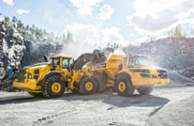
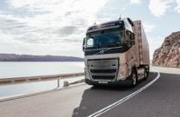
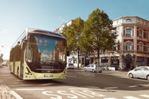
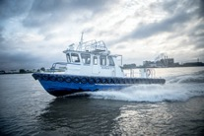
What we do
Volvo Group offers trucks, buses, construction equipment, power solutions for marine and industrial applications, financing and services that increase our customers’ uptime and productivity.
We contribute to the development of electrified and autonomous solutions for the benefit of customers, society and for the environment.

Slide 39
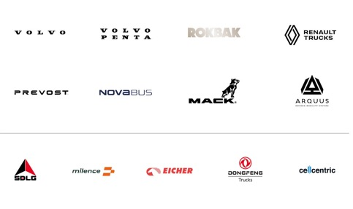
Our brands
Volvo Group’s brand portfolio
consists of several distinct brands,
targeting a variety of customers
and segments.

Slide 40
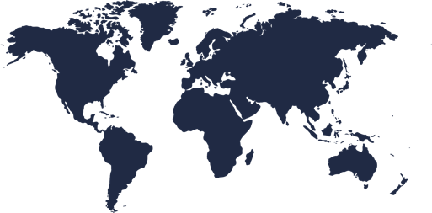
Global presence
NORTH AMERICA
EUROPE
ASIA
29%
137 BSEK
19%
40%
191 BSEK
61%
14%
64 BSEK
11%
SE
*
VOLVO GROUP HQ, GOTHENBURG, SWEDEN
RU
CA
GB
DE
PL
102,000 employees
Production in 18 countries
190 markets
Worldwide service networks and dealerships
BE
FR
US
KR
CN
SA
MX
IN
TH
MY
BR
SOUTH AMERICA
AFRICA & OCEANIA
AU
ZA
11%
52 BSEK
7%
6%
29 BSEK
2%
Share of net sales by market (2022)
Share of total employees (2021)
Countries with Volvo Group production
* Production activities in Russia have been suspended since February 2022.

Slide 41
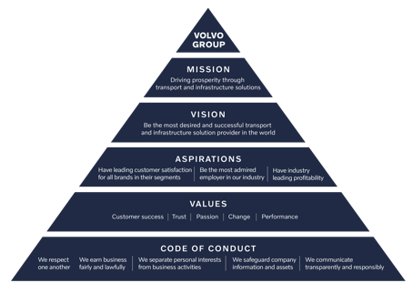
Shaping the world we want to live in
Our mission is to drive prosperity through transport and infrastructure solutions.

Slide 42
Net sales
Share of net sales by segment
Volvo Group’s net sales 2018-2022, BSEK.
Share of net sales by revenue type

Slide 43
Adjusted operating income
Volvo Group’s adjusted operating income 2018–2022, BSEK.
2022:10.7%
2021: 11.0%
2020: 8.4%
2019: 11.1%
2018: 10.4%
Adjusted
operating margin:

Slide 44
we shape the world
Together
we want to live in
Volvo Group

Slide 46
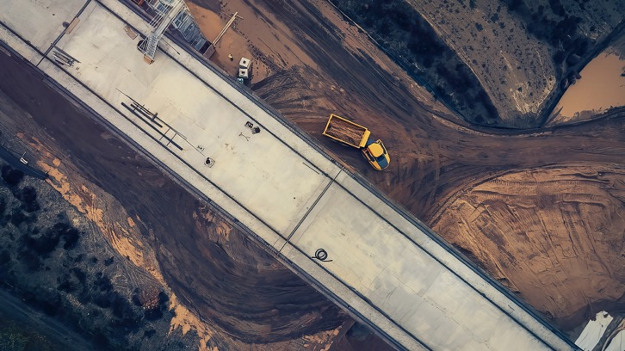
Volvo CE in different industry segments

Slide 47
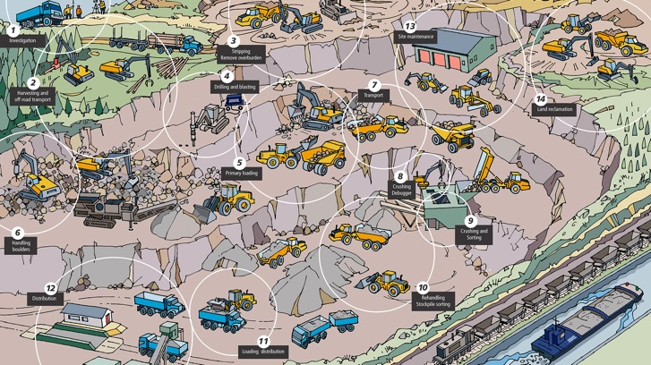
Quarry & aggregates

Slide 48
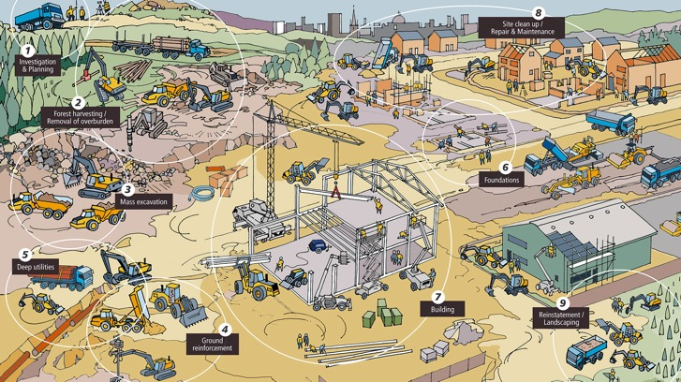
Building
Building

Slide 49
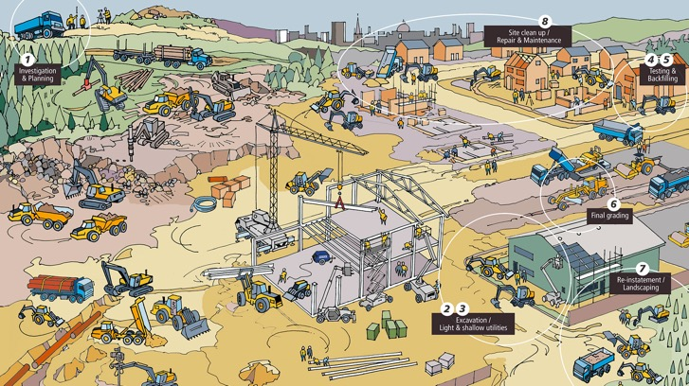
Utilities

Slide 50
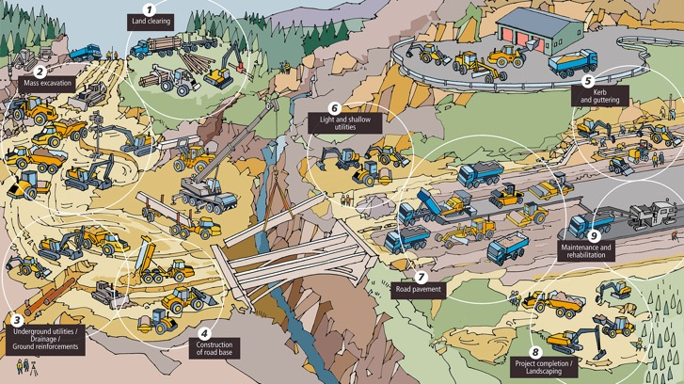
Road Construction

Slide 51
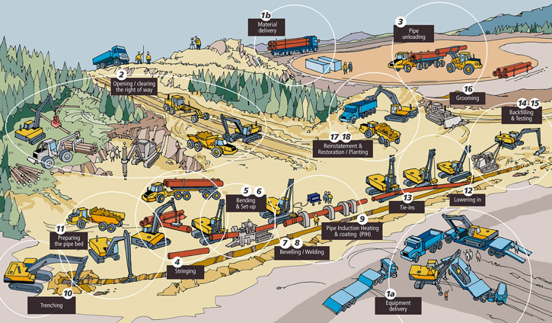
Oil & gas

Slide 52
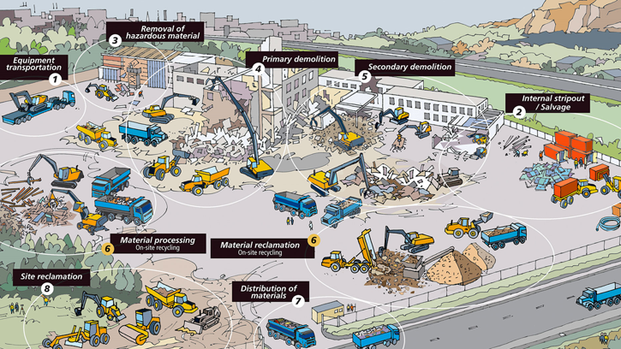
Demolition

Slide 53
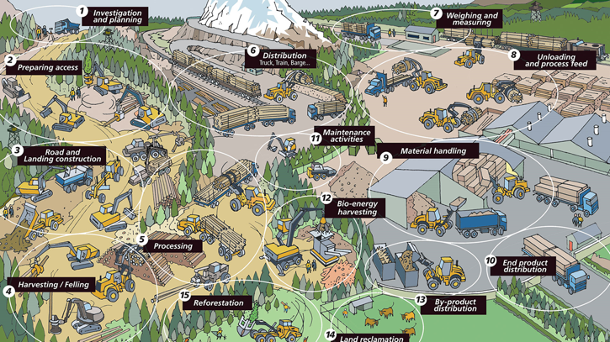
Forestry

Slide 54
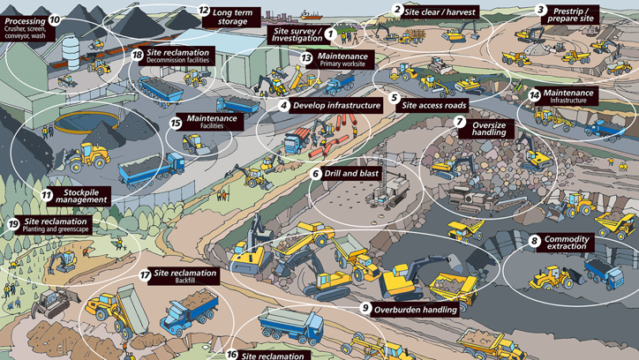
Mining

